Slide 1
Data Pre-processing

Slide 2
Machine Learning Process
Test
Data
Model
Training &
Building
Data
Acquisition
Data
Cleaning
Model
Testing
Model
Deployment

Slide 3
Data Preprocessing
Data preprocessing is the process of transforming raw data into an understandable format.
It is also an important step in data mining as we cannot work with raw data.
The quality of the data should be checked before applying machine learning or data mining algorithms.

Slide 4
Why Data preprocessing is important?
Preprocessing of data is mainly to check the data quality. The quality can be checked by the following
Accuracy: To check whether the data entered is correct or not.
Completeness: To check whether the data is available or not recorded.
Consistency: To check whether the same data is kept in all the places that do or do not match.
Timeliness: The data should be updated correctly.
Believability: The data should be trustable.
Interpretability: The understandability of the data.

Slide 5
One more reason:
When we talk about data, we usually think of some large datasets with a huge number of rows and columns.
While that is a likely scenario, it is not always the case — data could be in so many different forms: Structured Tables, Images, Audio files, Videos, etc..
Machines don’t understand free text, image, or video data as it is, they understand 1s and 0s.
So it probably won’t be good enough if we put on a slideshow of all our images and expect our machine learning model to get trained just by that!

Slide 6
Features in Machine Learning
A dataset can be viewed as a collection of data objects, which are often also called as a records, points, vectors, patterns, events, cases, samples, observations, or entities. Data objects are described by a number of features, that capture the basic characteristics of an object, such as the mass of a physical object or the time at which an event occurred, etc..
A feature is an individual measurable property or characteristic of a phenomenon being observed
Features are often called as variables, characteristics, fields, attributes, or dimensions.
For instance, color, mileage and power can be considered as features of a car.

Slide 7
TASK 1: Identify the features for the following problems
Rainfall Prediction
Movie Recommendation
Predict the shoe sale at a particular store

Slide 8
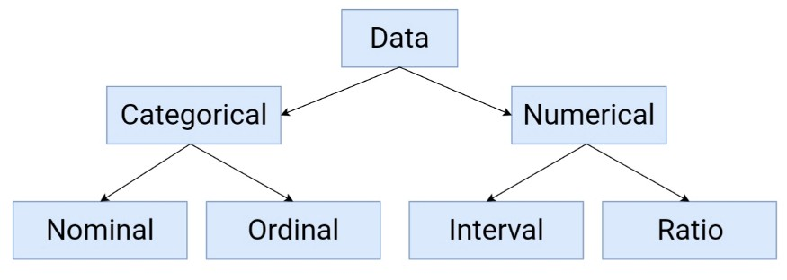
Types of Features

Slide 9
Features can be:
Categorical :
Features whose values are taken from a defined set of values. For instance, days in a week : {Monday, Tuesday, Wednesday, Thursday, Friday, Saturday, Sunday} is a category because its value is always taken from this set.
Another example could be the Boolean set : {True, False}
Numerical :
Features whose values are continuous or integer-valued.
They are represented by numbers and possess most of the properties of numbers.
For instance, number of steps you walk in a day, or the speed at which you are driving your car at.

Slide 10
TASK 2: IDENTIFY THE TYPE OF FEATURE
GRADES OF A STUDENT
THE EXAT MARKS WHICH A STUDENT GOT IN A SEMESTER.

Slide 11
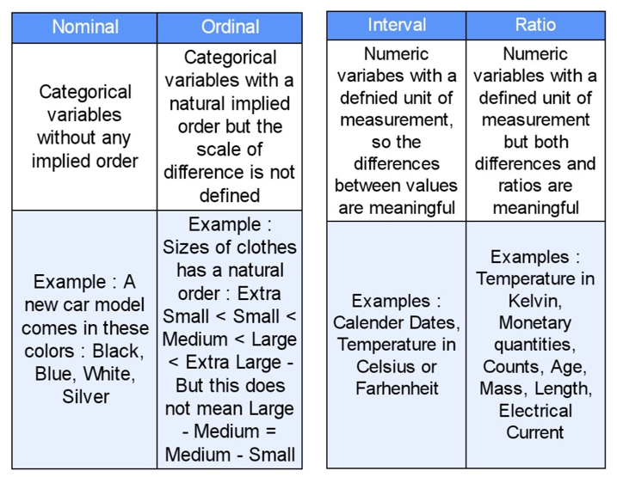

Slide 12
TASK 2: IDENTIFY THE TYPE OF FEATURE
COUNTRY OF A PERSON
B. How was your customer service experience?
Good
Neutral
Bad
C. BODY MASS INDEX
D. pH Values
E. What color hair do you have?
Brown
Blonde
Black
Blue

Slide 13
TASK 2: IDENTIFY THE TYPE OF FEATURE
COUNTRY OF A PERSON → nominal
B. How was your customer service experience? → ordinal
Good
Neutral
Bad
C. BODY MASS INDEX → ratio
D. pH Values → interval
E. What color hair do you have? → NOMINAL
Brown
Blonde
Black
Blue

Slide 14
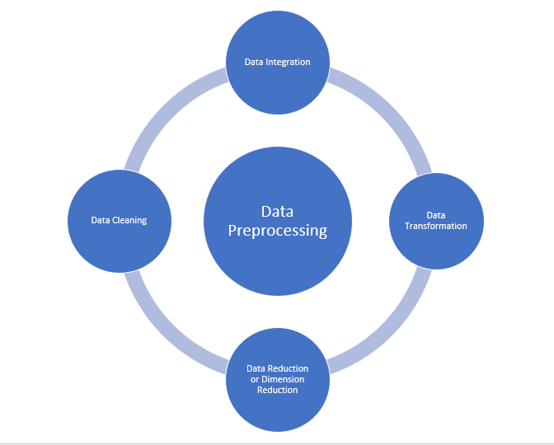
Major Tasks in Data Preprocessing:
Data cleaning
Data integration
Data reduction
Data transformation

Slide 15
DATA CLEANING
Data cleaning
Data integration
Data reduction
Data transformation

Slide 16
Data cleaning:
Data cleaning is the process to remove incorrect data, incomplete data and inaccurate data from the datasets, and it also replaces the missing values.
There are some techniques in data cleaning.

Slide 17
Handling missing values:
It can be handled in various ways. Some of these are: Ignore the tuples and fill the missing values
Standard values like “Not Available” or “NA” can be used to replace the missing values.
Missing values can also be filled manually but it is not recommended when that dataset is big.
The attribute’s mean value can be used to replace the missing value when the data is normally distributed wherein in the case of non-normal distribution median value of the attribute can be used.
While using regression or decision tree algorithms the missing value can be replaced by the most probable value.

Slide 18
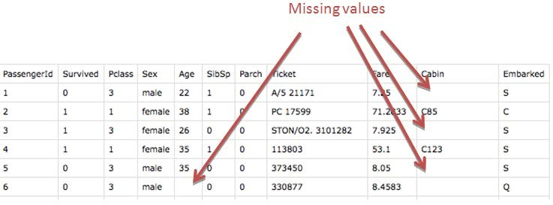
Handling missing values:

Slide 19
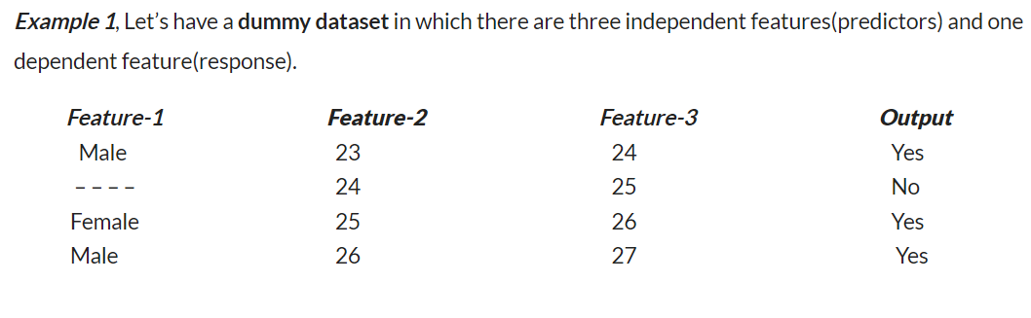

Slide 20
.Delete the observations: If there is a large number of observations in the dataset, where all the classes to be predicted are sufficiently represented in the training data, then try deleting the missing value observations, which would not bring significant change in your feed to your model.
For Example,1, Implement this method in a given dataset, we can delete the entire row which contains missing values(delete row-2).

Slide 21
Replace missing values with the most frequent value: You can always impute them based on Mode in the case of categorical variables, just make sure you don’t have highly skewed class distributions.
For Example, 1, To implement this method, we replace the missing value by the most frequent value for that particular column, here we replace the missing value by Male since the count of Male is more than Female (Male=2 and Female=1).

Slide 22
Develop a model to predict missing values:
One smart way of doing this could be training a classifier over your columns with missing values as a dependent variable against other features of your data set and trying to impute based on the newly trained classifier.
https://www.analyticsvidhya.com/blog/2021/04/how-to-handle-missing-values-of-categorical-variables/

Slide 23
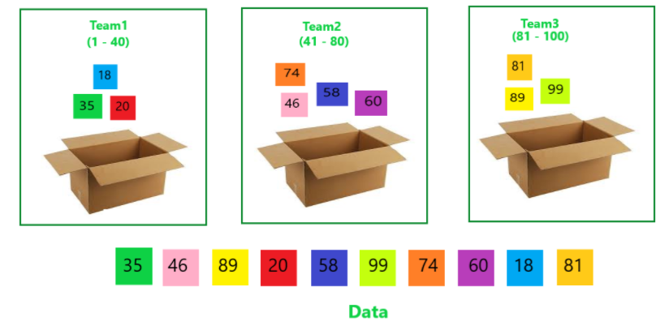
Noisy:
Noisy generally means random error or containing unnecessary data points. Here are some of the methods to handle noisy data.
I. Binning: This method is to smooth or handle noisy data. First, the data is sorted then and then the sorted values are separated and stored in the form of bins. There are three methods for smoothing data in the bin.

Slide 24
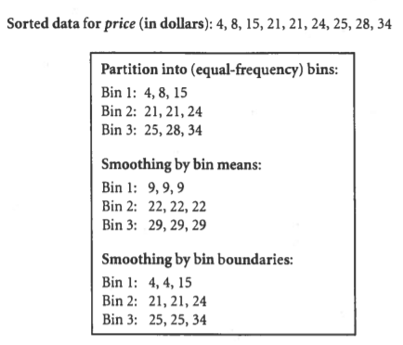
Smoothing by bin mean method: In this method, the values in the bin are replaced by the mean value of the bin;
Smoothing by bin median: In this method, the values in the bin are replaced by the median value;
Smoothing by bin boundary: In this method, the using minimum and maximum values of the bin values are taken and the values are replaced by the closest boundary value.

Slide 25
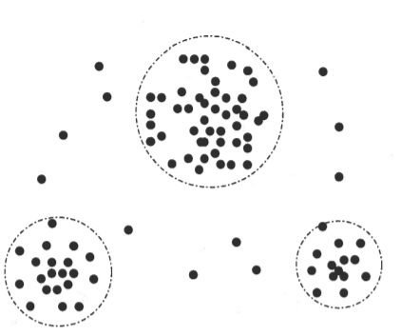
Regression:
This is used to smooth the data and will help to handle data when unnecessary data is present.
For the analysis, purpose regression helps to decide the variable which is suitable for our analysis.
Clustering:
This is used for finding the outliers and also in grouping the
data.
Clustering is generally used in unsupervised learning.

Slide 26
DATA INTEGRATION
Data cleaning
Data integration
Data reduction
Data transformation

Slide 27
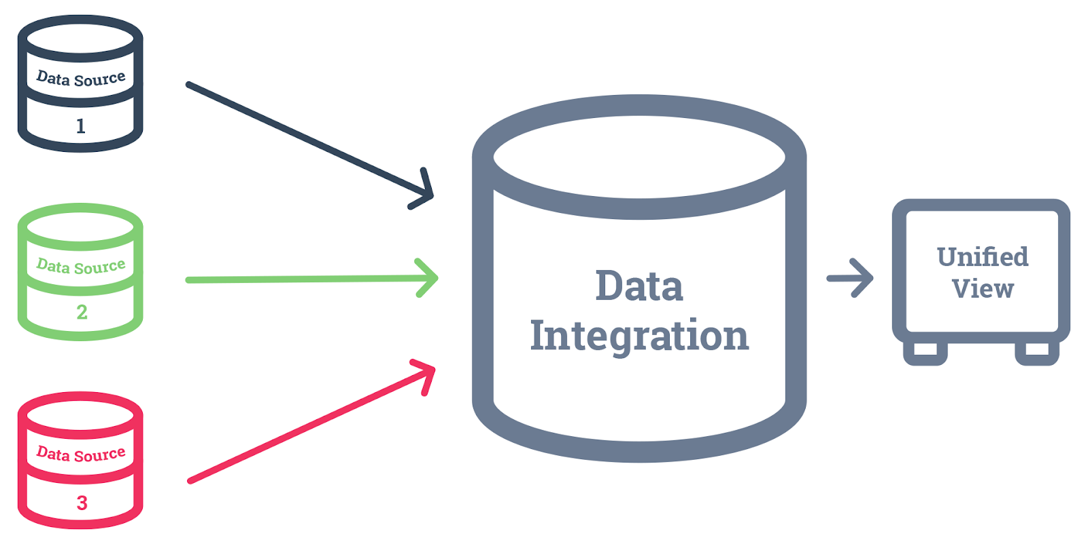
Data Integration:
The process of combining multiple sources into a single dataset.
The Data integration process is one of the main components in data management.
There are some problems to be considered during data integration.

Slide 28
Data Integration Techniques
Schema integration: Integrates metadata(a set of data that describes other data) from different sources.
Entity identification problem: Identifying entities from multiple databases. For example, the system or the user should know student _id of one database and student_name of another database belongs to the same entity.
Detecting and resolving data value concepts: The data taken from different databases while merging may differ. Like the attribute values from one database may differ from another database. For example, the date format may differ like “MM/DD/YYYY” or “DD/MM/YYYY”.

Slide 29
DATA REDUCTION
Data cleaning
Data integration
Data reduction
Data transformation

Slide 30
Data reduction:
This process helps in the reduction of the volume of the data which makes the analysis easier yet produces the same or almost the same result.
This reduction also helps to reduce storage space.
There are some of the techniques in data reduction are Dimensionality reduction, Numerosity reduction, Data compression.

Slide 31
Dimensionality reduction:
This process is necessary for real-world applications as the data size is big. In this process, the reduction of random variables or attributes is done so that the dimensionality of the data set can be reduced.
Combining and merging the attributes of the data without losing its original characteristics.
This also helps in the reduction of storage space and computation time is reduced.
When the data is highly dimensional the problem called “Curse of Dimensionality” occurs.

Slide 32
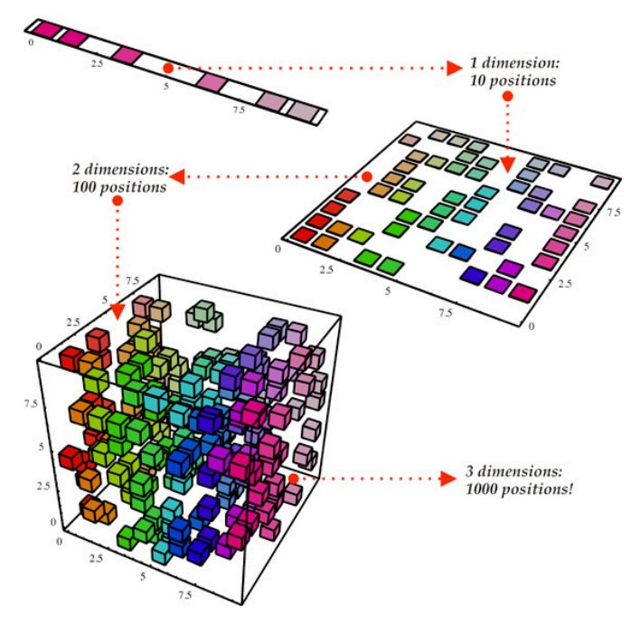
Dimensionality reduction:

Slide 33
B. Numerosity Reduction:
Numerosity Reduction is a data reduction technique which replaces the original data by smaller form of data representation.
There are two techniques for numerosity reduction- Parametric and Non-Parametric methods
Parametric → Regression
Non-Parametric methods→ clustering, Data cube aggregation, sampling
https://www.geeksforgeeks.org/numerosity-reduction-in-data-mining/#:~:text=Numerosity%20Reduction%20is%20a%20data,Parametric%20and%20Non%2DParametric%20methods.

Slide 34
C. Data compression:
The compressed form of data is called data compression.
This compression can be lossless or lossy.
When there is no loss of information during compression it is called lossless compression.
Whereas lossy compression reduces information but it removes only the unnecessary information.

Slide 35
DATA TRANSFORMATION
Data cleaning
Data integration
Data reduction
Data transformation

Slide 36
Data Transformation
The change made in the format or the structure of the data is called data transformation.
This step can be simple or complex based on the requirements. There are some methods in data transformation.
Smoothing
Aggregation
Discretization
Normalization
Attribute Selection

Slide 37
A. Smoothing:
With the help of algorithms, we can remove noise from the dataset and helps in knowing the important features of the dataset.
By smoothing we can find even a simple change that helps in prediction.
https://corporatefinanceinstitute.com/resources/knowledge/other/data-smoothing/
https://rafalab.github.io/dsbook/smoothing.html

Slide 38
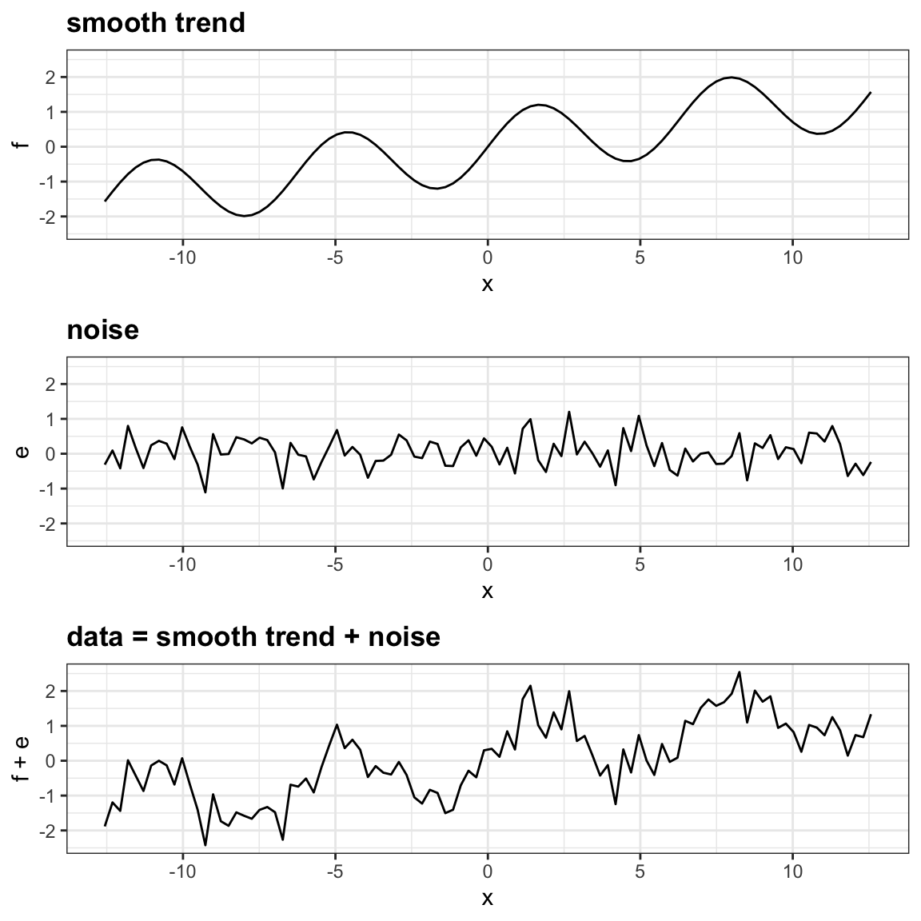

Slide 39
B. Aggregation:
In this method, the data is stored and presented in the form of a summary.
The data set which is from multiple sources is integrated into with data analysis description.
This is an important step since the accuracy of the data depends on the quantity and quality of the data.
When the quality and the quantity of the data are good the results are more relevant.

Slide 40
C. Discretization:
The continuous data here is split into intervals.
Discretization reduces the data size.
For example, rather than specifying the class time, we can set an interval like (3 pm-5 pm, 6 pm-8 pm).

Slide 41
D. Normalization:
It is the method of scaling the data so that it can be represented in a smaller range.
Example ranging from -1.0 to 1.0.

Slide 42
HOW TO APPLY WHAT WE HAVE LEARNT SO FAR..
Not all the steps are applicable for each problem, it is highly dependent on the data we are working with, so maybe only a few steps might be required with your dataset.
Generally, they are :
Data Quality Assessment
Feature Aggregation
Feature Sampling
Dimensionality Reduction
Feature Encoding

Slide 43
Data Quality Assessment
Check for:
Missing Values
Inconsistent Values
Duplicate Values

Slide 44
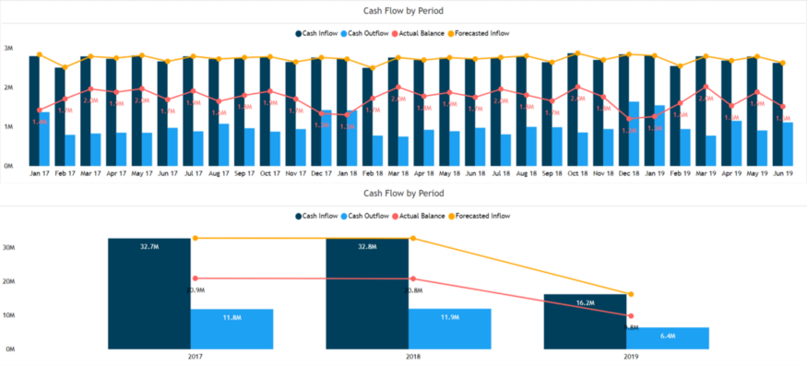
Feature Aggregation

Slide 45
Feature Sampling
Sampling is a very common method for selecting a subset of the dataset that we are analyzing.
The key principle here is that the sampling should be done in such a manner that the sample generated should have approximately the same properties as the original dataset, meaning that the sample is representative.
This involves choosing the correct sample size and sampling strategy.

Slide 46
Feature Sampling
Simple Random Sampling dictates that there is an equal probability of selecting any particular entity. It has two main variations as well :
Sampling without Replacement : As each item is selected, it is removed from the set of all the objects that form the total dataset.
Sampling with Replacement : Items are not removed from the total dataset after getting selected. This means they can get selected more than once.

Slide 47
Feature Sampling
There is another sampling technique which we can use, called Stratified Sampling, which begins with predefined groups of objects.
There are different versions of Stratified Sampling too, with the simplest version suggesting equal number of objects be drawn from all the groups even though the groups are of different sizes.

Slide 48
Dimensionality Reduction
The basic objective of techniques which are used for this purpose is to reduce the dimensionality of a dataset by creating new features which are a combination of the old features.
In other words, the higher-dimensional feature-space is mapped to a lower-dimensional feature-space.
Principal Component Analysis and Singular Value Decomposition are two widely accepted techniques.

Slide 49
Feature encoding
Feature encoding is basically performing transformations on the data such that it can be easily accepted as input for machine learning algorithms while still retaining its original meaning.

Slide 50
REFERENCES
https://www.analyticsvidhya.com/blog/2021/08/data-preprocessing-in-data-mining-a-hands-on-guide/
https://www.javatpoint.com/data-preprocessing-machine-learning
https://www.geeksforgeeks.org/data-preprocessing-in-data-mining/
https://towardsdatascience.com/data-preprocessing-concepts-fa946d11c825

